Slide 1

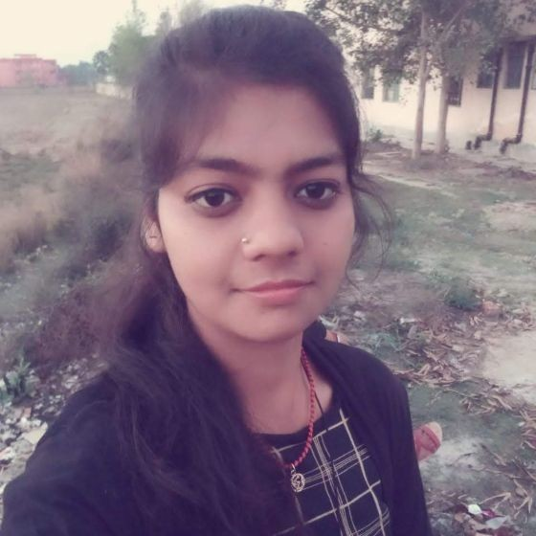



POOJA KUMARI
Education and certificates :
Bachelor Of Technology
Computer Science & Engineering :
2017 – 2021
Skills
Analyst/Software Engineer
Base Location: Mumbai
Email ID: pooja.t.kumari@capgemini.com
Mobile No: +918404945932, 6200733266
Grade: A4
java | java,OOPS,Generics, Collections, Array,Loops,
Backend | Spring Boot,Spring Rest Services, Spring RestFul Service, Node Js
Database | Postgre SQL
UI Tech | HTML5 & CSS3, JavaScript,Es6,Bootsrap 4
Tools | Git & GitHub, Eclipse, STS Post man,Swagger,Visual Studio , Pg Admin 4, SQL shell.
Add On skills | Immersive Learning and Java Team Management.
Strengths
Full Stack Developer
Hands on experience on Core java, Post gre SQL, Entityframework, SqlServer, Spring Restfull Services.
Proficient in creating Single page Web Application in React with Authentication with routing
Hands on experience in developing web pages using HTML5, CSS, Object TypeScript, Good understanding of Document Object Model (DOM) and DOM Functions
Ready to learn new technologies and implement them for the Future Knowledge improvement.
Achievement
Health Insurance
Case study of Health Insurance Management(the system will provide screen to show the policies available calculate Premium, register and login to purchase the policies.) using spring boot as backend along with swagger for testing .
React as frontend, used HTML5,CSS,ES6 and bootstrap for designing responsive web pages .
https://github.com/PoojaKumari-310
Presentation Title | Author | Date © Capgemini 2017. All rights reserved | 1

